Slide 1

INNOMATICS RESEARCH LABS
DATA SCIENCE COURSE

Slide 2
AIRCRAFT ACCIDENTS & INCIDENTS
PRESENTATION – NADELLA SITA RAMA PAVANI

Slide 3
CONTENTS :
DATA SCIENCE INTRODUCTION
WHY DATA SCIENCE
PILLARS OF DATA SCIENCE
CATEGORIES INVOLVED
WEB SCRAPING
CONCLUSION

Slide 4
What is Data Science?
Data science is the field of study that combines domain expertise, programming skills, and knowledge of mathematics, statistics to extract meaningful insights from data.
Data science practitioners apply MACHINE LEARNING ALGORITHMS to numbers, text, images, video, audio, and more to produce ARTIFICIAL INTELLIGENCE systems to perform tasks that ordinarily require human intelligence.

Slide 5
Why do we need Data Science?
The fundamental goal of data science is to help companies make quicker and better decisions, which can take them to the top of their market, or at least – especially in the toughest red oceans – be a matter of long-term survival. The number of companies prepared to use big data is increasing.

Slide 6
The Pillars of Data Science Expertise:
Business/Domain
Mathematics (includes statistics and probability)
Computer science (e.g., software/data architecture and engineering)
Communication (both written and verbal)

Slide 7
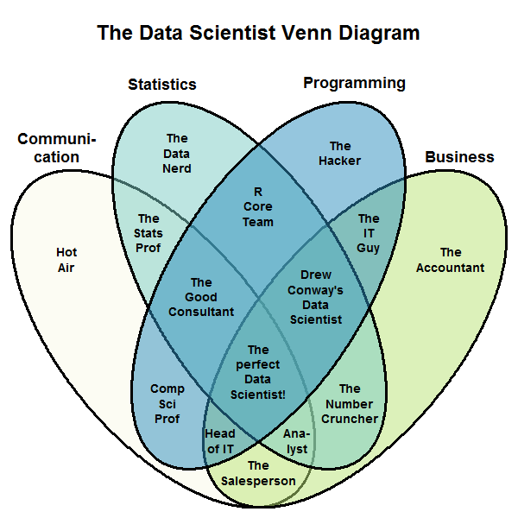

Slide 8
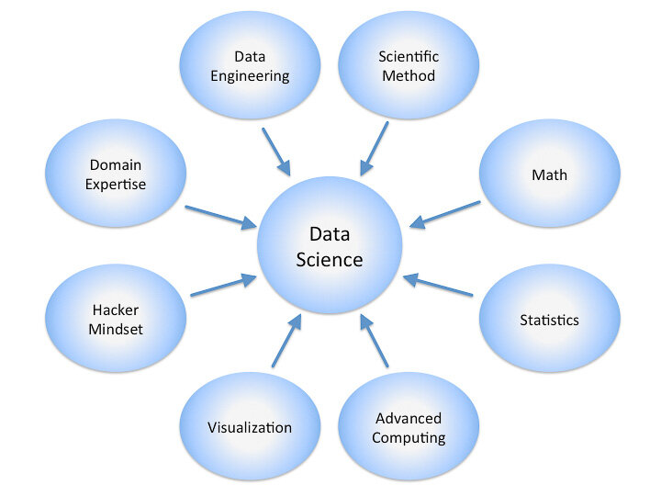
VARIOUS CATEGORIES INVOLVED:

Slide 9
WEB SCRAPING:
Web scraping, or Web data extraction is data scraping used for extracting data from websites directly.
Web scraping can be done manually by a software user, refers to automated processes implemented using a web crawler - copying data from the web, typically into a central local database or spreadsheet, for later retrieval or analysis.

Slide 10
SCRAPING OUT THE DATA FROM WIKIPEDIA:
TITLE:
List Of Aircraft Accidents & Incidents Resulting In At Least 50 Fatalities
Reference URL: https://en.wikipedia.org/wiki/List_of_aircraft_accidents_and_incidents_resulting_in_at_least_50_fatalities

Slide 11
STEPS INVOLVED IN WEB SCRAPING:
Importing The Necessary Libraries
Accessing & Parsing The Html Content From Webpage
Extract The Required Tables From The URL
Scraping The Data From The Webpage
Concatenate The Two Data Frames Along Columns
View Of Final Data Fame
Export The Data Frame To Excel/Csv
Filling The Null Values If Required (Optional)
Cleaning The Data Frame Using Regular Expressions
Exploratory Data Analysis (Eda)
Plotting Of The Graphs
Final Conclusion – Observations From The Graphs

Slide 12
PLOTS : Graphical Representation
MATPLOTLIB
SEABORN
PLOTLY

Slide 13
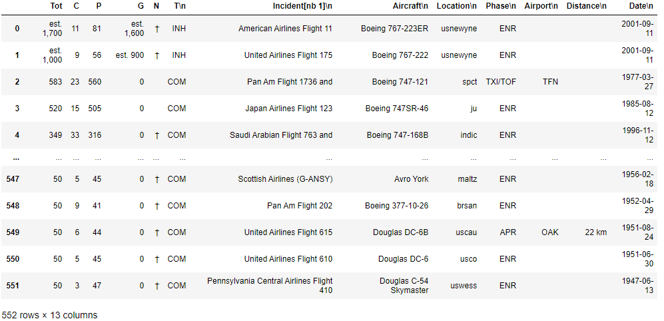
DATA FRAME

Slide 14
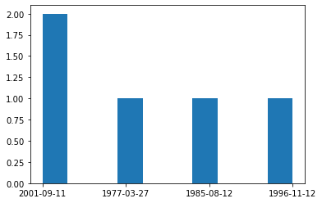
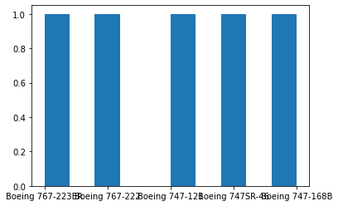
HISTOGRAM – Univariate Analysis: Representation of the distribution of numerical data, where the data are binned and the count for each bin is represented.
OBSERVATION:
Incident is high with American Airlines Flight 11, Aircraft:- Boeing 767-223ER: 81 Passengers(P), 11 Crew(C) were dead by Hijacking(T: INH) on En Route(Phase) on 11-09-2001(Date) at New York City, US(Location).

Slide 15
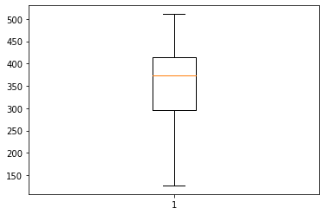
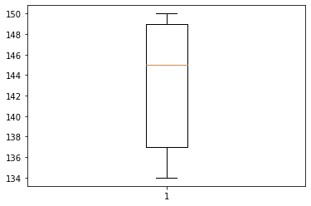
BOXPLOT - UNIVARIATE ANALYSYS: A measure of the distribution of data in a Data Frame.
It divides the data set into three quartiles representing the minimum, maximum, median, first quartile and third quartile in the Data Frame.
OBSERVATION:
Incident is high with Trigana Air Flight 267, Aircraft:- ATR 42-300: 49 Passengers(P), 5 Crew(C) were dead by Commercial (T: accident/incident) on En Route(Phase) on 16-8-2015(Date) at Mount Tangok, Pegunungan Bintang Regency, Papua, Indonesia(Location).

Slide 16
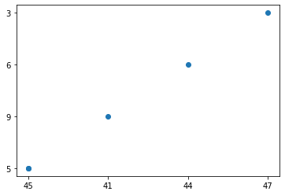
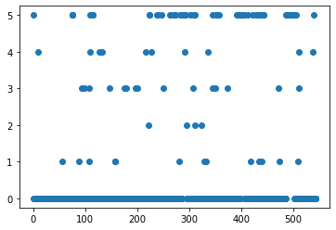
SCATTER PLOT: It's a diagram where each value in the Data Frame is represented by a dot.
Matplotlib module - drawing scatter plots, it needs two arrays of the same length, one for the values of the x-axis, and one for the values of the y-axis.
OBSERVATION:
Incident is high with American Airlines Flight 11, Aircraft:- Boeing 767-223ER: 81 Passengers(P), 11 Crew(C), 1,700 Estimation were dead by Hijacking (T: INH) on En Route(Phase) on 11-9-2001(Date) at New York City, New York, U.S (Location).

Slide 17
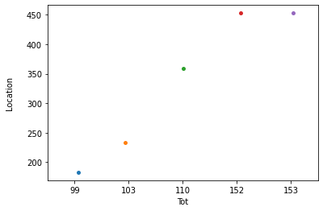
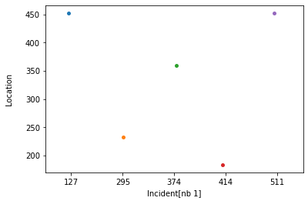
STRIP PLOT: It's a graphical data analysis for summarizing a Uni/Bivariate data set.
Typically used for small Data Frame (histograms and density plots are typically preferred for larger data sets).
OBSERVATION:
Incident is high with United Airlines Flight 175, Aircraft:- Boeing 767-222: 56 Passengers(P), 9 Crew(C), 1,000 Estimation were dead by Hijacking (T: INH) on En-Route(ENR) on 11-9-2001 (Date) at New York City, New York, U.S (Location).

Slide 18
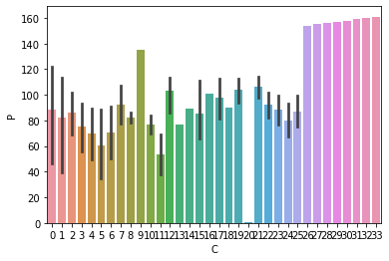
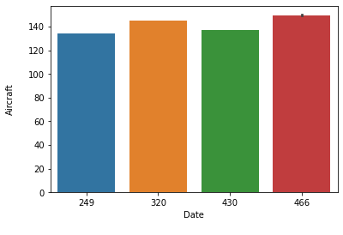
BAR GRAPH - BIVARIATE ANALYSIS: A bar graph represents categorical data with rectangular bars with heights or lengths proportional to the values that they represent. The bars can be plotted vertically or horizontally. A vertical bar chart is sometimes called a column chart.
OBSERVATION:
Incident is high with American Airlines Flight 11, Aircraft:- Boeing 767-223ER: 81 Passengers(P), 11 Crew(C), 1,700 Estimation were dead by Hijacking (T: INH) on En Route(Phase) on 11-9-2001(Date) at New York City, New York, U.S (Location).
Incident is high with United Airlines Flight 175, Aircraft:- Boeing 767-222: 56 Passengers(P), 9 Crew(C), 1,000 Estimation were dead by Hijacking (T: INH) on En Route(Phase) on 11-9-2001(Date) at New York City, New York, U.S (Location)

Slide 19
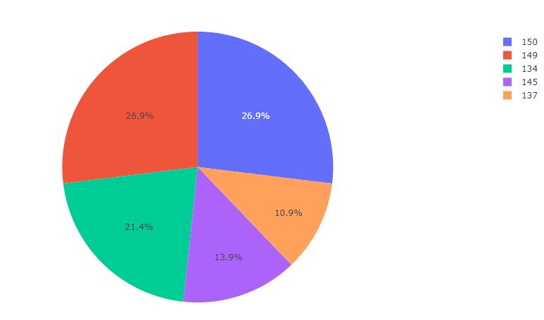
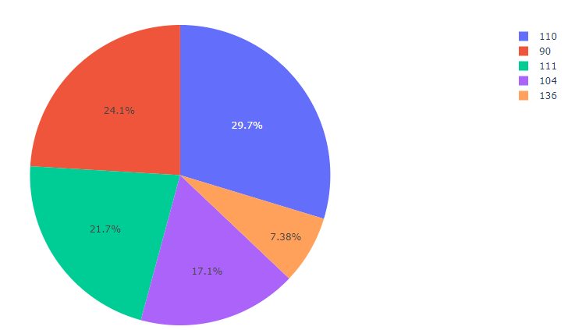
PIE CHART: A pie chart (or a circle chart) is a circular statistical graphic, which is divided into slices to illustrate numerical proportion. The arc length of each slice is proportional to the quantity it represents.
OBSERVATIONS:
Incident is high with Airblue Flight 202, Aircraft:- Airbus A321-231: 146 Passengers(P), 6 Crew(C), were dead by Commercial (T: accident/incident) on Approach(Phase) on 28-7-2010(Date) from a distance of 15km (9.3 mi) at Islamabad, Pakistan APR(Location).
Incident is high with Yemenia Flight 626, Aircraft:- Airbus A310-324: 141 Passengers(P), 11 Crew(C), were dead by Commercial (T: accident/incident) on Approach(Phase) on 30-6-2009(Date) from a distance of 40km (25 min) at Mozambique Channel off Mitsamiouli, Comoros(Location).

Slide 20
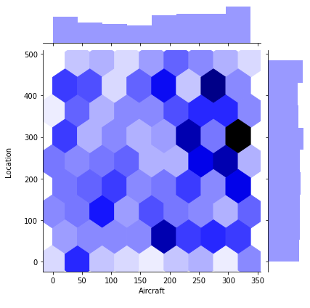
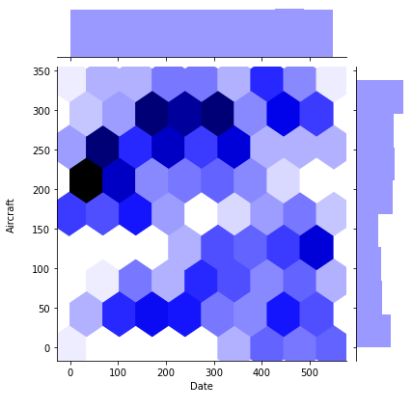
HEXBIN PLOT: It represent the relationship of 2 numerical variables when lots of data points. Instead of overlapping, the plotting window is split in several hexbins & number of points per hexbin is counted - color denotes this number of points.
OBSERVATION:
Incident is high with Sosoliso Airlines Flight 1145, Aircraft:- McDonnell Douglas DC-9-32: 101 Passengers(P), 7 Crew(C), were dead by Commercial (T: accident/incident) on PHC(Phase) on 10-12-2005(Date) at Port Harcourt, Nigeria, LDG (Location).

Slide 21
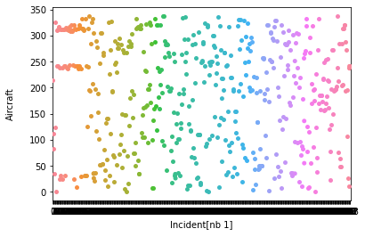
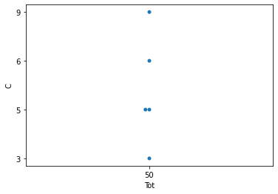
SWARM PLOT: A categorical scatterplot where the points do not overlap. These plots resemble bees swarming.
OBSERVATION:
Incident is high with Cebu Pacific Air Flight 387, Aircraft:- McDonnell Douglas DC-9-32: 99 Passengers(P), 5 Crew(C), were dead by Commercial (T: accident/incident) on En Route(Phase) on 02-2-1998(Date) at Mount Balatukan, Philippines(Location).

Slide 22
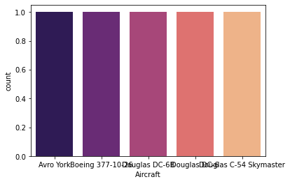
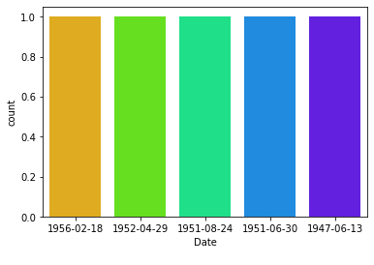
COUNT PLOT: It can be thought of as a histogram across a categorical, instead of quantitative, variable. The basic API and options are identical to those for bar plot , so we can compare counts across nested variables.
OBSERVATION:
Incident is high with American Airlines Flight 11, Aircraft:- Boeing 767-223ER: 81 Passengers(P), 11 Crew(C), 1,700 Estimation were dead by Hijacking (T: INH) on En Route(Phase) on 11-9-2001(Date) at New York City, New York, U.S (Location).

Slide 23
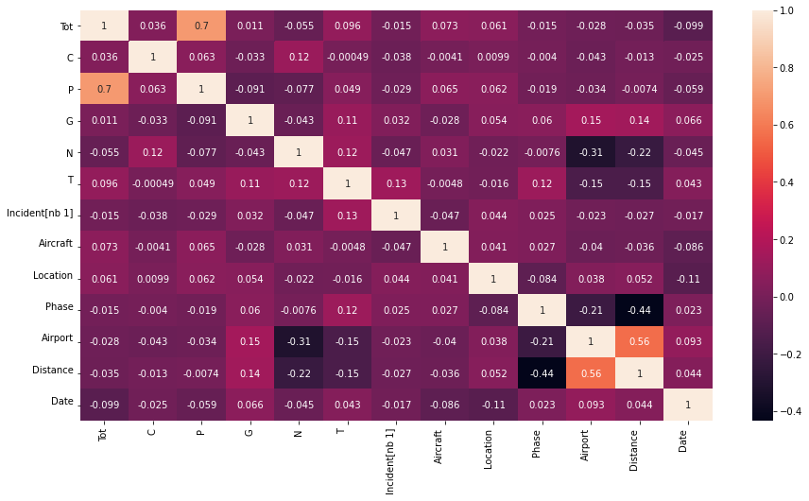
CORRELATION BETWEEN DIFFERENT VARIABLES:

Slide 24
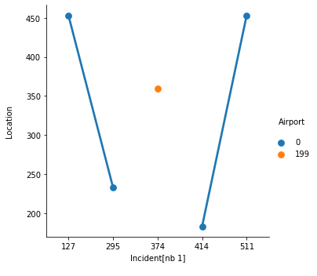
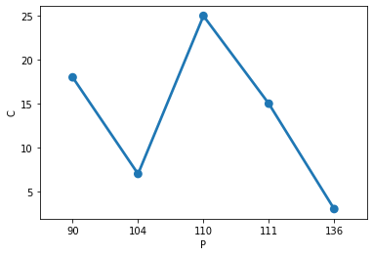
POINT PLOT: In seaborn, Point plot means a scatter plot depicting point estimations for categories with defined confidence intervals. The point plot also draws error lines (also called as bars or glyphs) that are extended from the points to describe the dispersion or uncertainty of the point estimate.
OBSERVATION:
Incident is high with American Airlines Flight 11, Aircraft:- Boeing 767-223ER: 81 Passengers(P), 11 Crew(C), 1,700 Estimation were dead by Hijacking (T: INH) on En Route(Phase) on 11-9-2001(Date) at New York City, New York, U.S (Location).

Slide 25
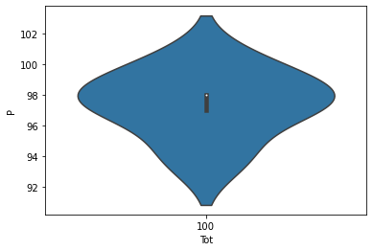
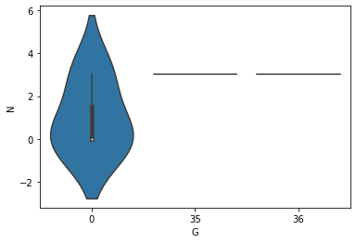
VIOLIN PLOT: A combination of boxplot and kernel density estimation, plays a similar role as a box and whisker plot. It shows the distribution of quantitative data across several levels of one (or more) categorical variables such that those distributions can be compared.
OBSERVATION:
Incident is high with Airblue Flight 202, Aircraft:- Airbus A321-231: 146 Passengers(P), 6 Crew(C), were dead by Commercial (T: COM - accident/incident) on Approach(Phase) from 15km (9.3 mi) on 28-7-2010(Date) at Islamabad, Pakistan (Location).

Slide 26
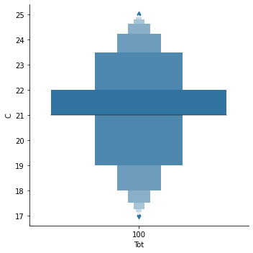
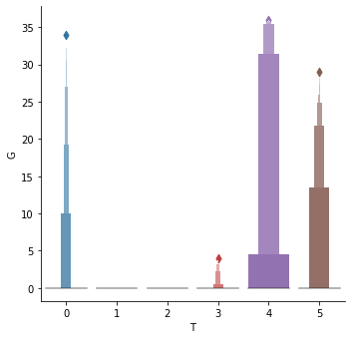
BOXEN PLOT: It is similar to a box plot in plotting a nonparametric representation of a distribution in which all features correspond to actual observations. By plotting more quantiles, it provides more information about the shape of the distribution, particularly in the tails.
OBSERVATION:
Incident is high with Iranian Air Force (5-8519), Aircraft:- Lockheed C-130E Hercules: 84 Passengers(P), 10 Crew(C), were dead by Military (T:MIL - accident/incident) on Approach(Phase) of 5.5 km (3.4 mi) on 06-12-2005(Date) at Tehran, Iran(Location).

Slide 27
FINAL CONCLUSION:
Incident with American Airlines Flight 11, Aircraft:- Boeing 767-223ER: 81 Passengers(P), 11 Crew(C), 1,700 Estimation were dead by Hijacking (T: INH) on En Route(Phase) on 11-9-2001(Date) at New York City, New York, U.S (Location) are more as per the graphical representation.
INCIDENT :
The incidents are more with the Commercial (accident/incident) with huge deaths.
The incidents are less with the Military (accident/incident), Bombing, Hijacking (accident/incident) with huge deaths.
PHASE :
For a Huge period - accidents were done during the En-route(ENR).
In some cases - accidents were done during the Approach(APR).
DEATH COMPARISION :
The death of Passengers(P) were huge when compared to the Crew(C) in the Cabin.
Rough Estimation is around 1,700.

Slide 28
CAPTION : Every new thing creates two new questions and two new opportunities.
THANK YOU

